Slide 1

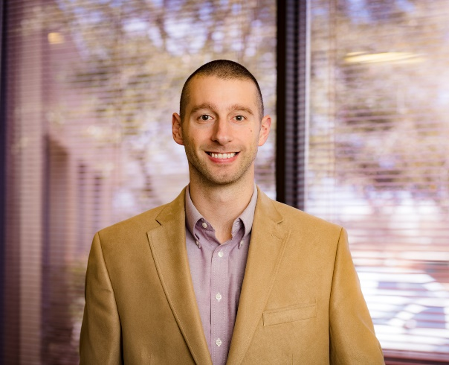
American Society of Heating, Refrigerating & Air Conditioning Engineers
Monthly meeting – November 4th, 2021
Neobem: The programmers choice for EnergyPlus
Mitchell Paulus Ph.D, PE, BEMP
Energy Engineer
Command Commissioning
Come see Dr. Paulus present on Neobem (website: neobem.io), a domain-specific programming language designed from the ground up to create EnergyPlus input files. Also, learn about the tools for creating your own domain-specific programming language without needing a computer science degree.
Time : Thursday, November 4, 2021 @ 6:00 pm
Venue : MEOB 301
FOOD AND SODA WILL BE SERVED!
(Engineers and Architects are encouraged to attend)
https://www.facebook.com/ASHRAE.TAMU/

